Slide 1
Shakespeare's Places
Poi – Avveduto, Cecire, Cinquetti

Slide 2

The project
Single page web application
Ten famous Shakespeare’s plays and their real-world locations
Component-Based Architecture

Slide 3


Website VS Web Application
Website:
Accessible using a browser
Has only informative content
Example: Wikipedia
Web application:
Accessible using a browser
Based on user’s interaction (it processes inputs)
Example: Gmail

Slide 4
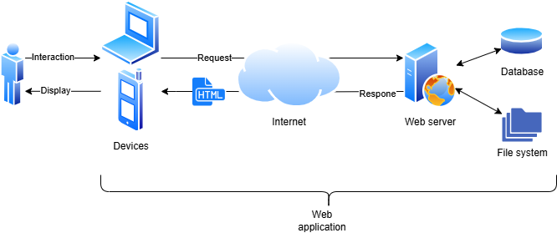
Web application schema

Slide 5
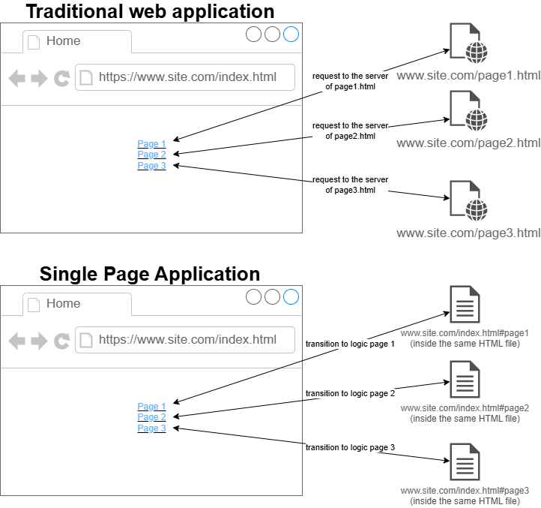
What is a Single Page Application (SPA)?
Web application written in JavaScript programming language
Only one HTML file that contains all the content
Only one request to the server
Page change is immediate (there isn’t a request to the server)

Slide 6
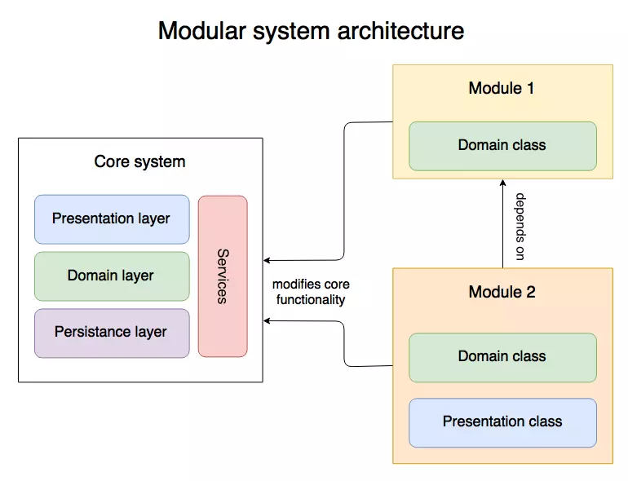
Component-Based architecture
Divide the development of separate parts of an application in single components
Developers work in parallel
Code is more readable and maintainable
Similiar components can be grouped in modules
Guided by:
Single Responsibility Principle: one component is responsible of only one thing
High Cohesion Principle: one component must do only one thing
Low Coupling Principle: one component has limited access to other components

Slide 7
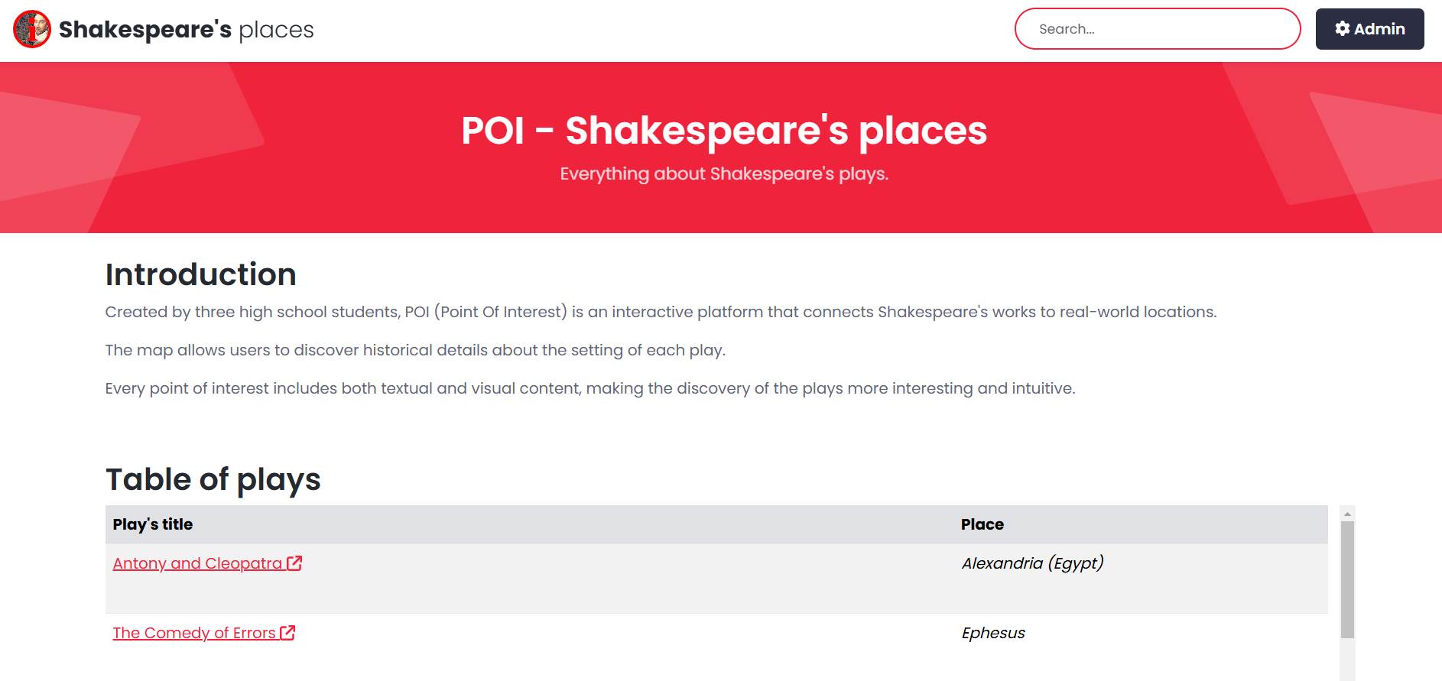
Navigation and organization of the app
Home page
One administration section
Different pages for all the plays
Search bar
Table and map of

Slide 8
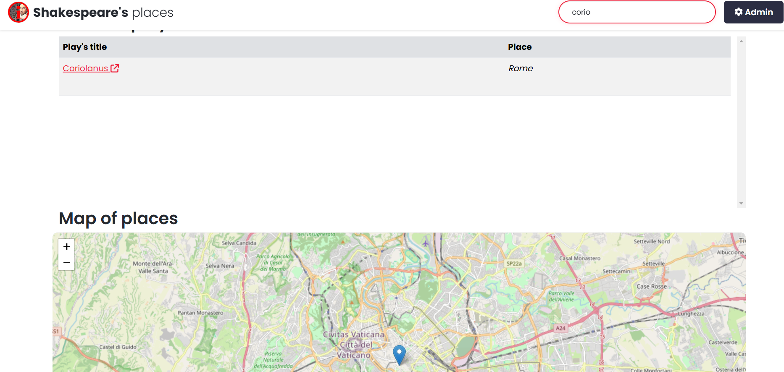
Searching articles
Search by play’s title
Search by place name

Slide 9
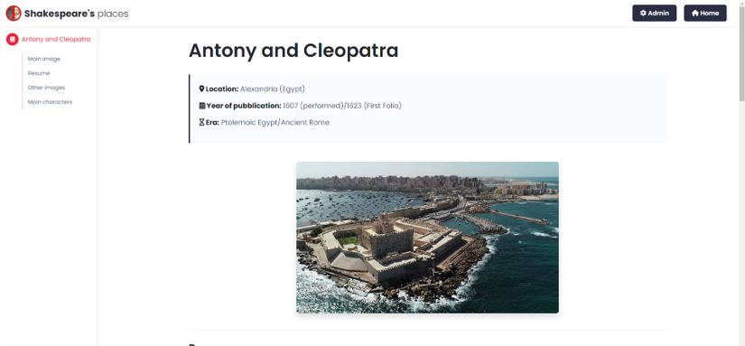
Play’s article
Location
Year of publication
Era
Images
Resume
Main characters
Despite the being an SPA every play has his own URL

Slide 10
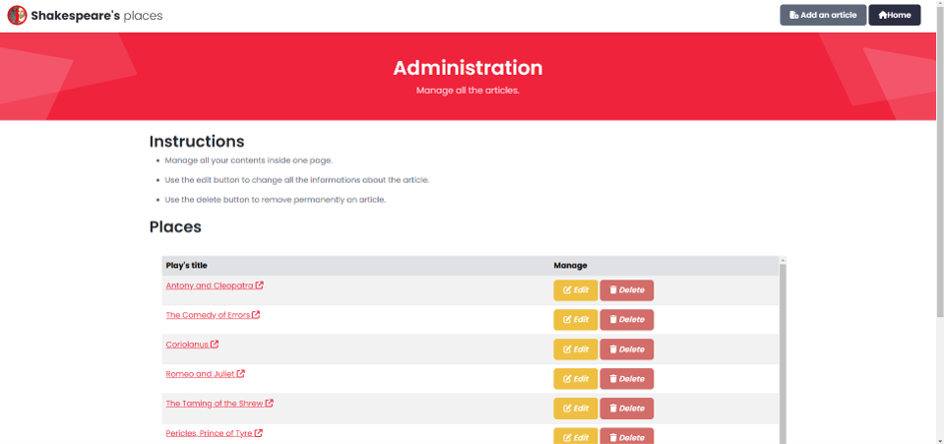
Administration section
Private section (has a login page)
Allows the creation, update and removal of articles

Slide 11
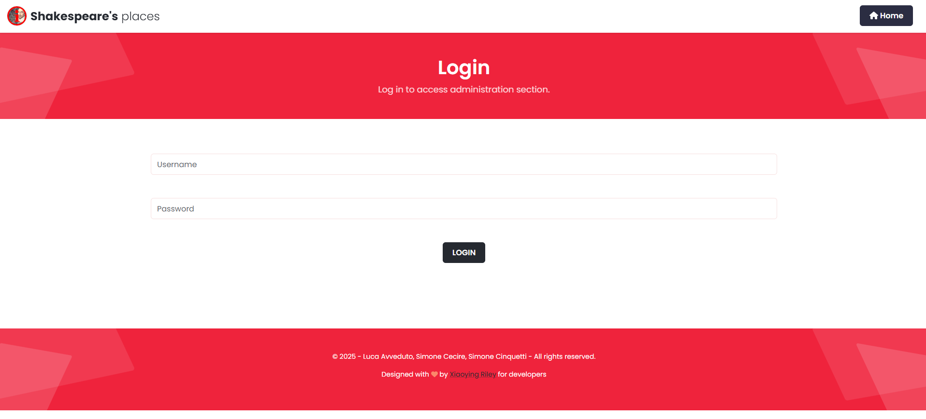
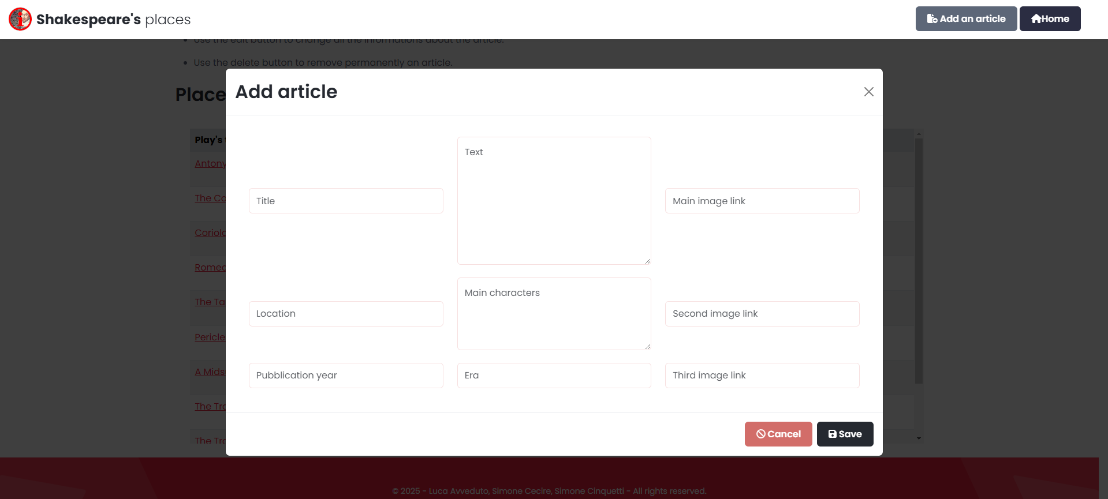
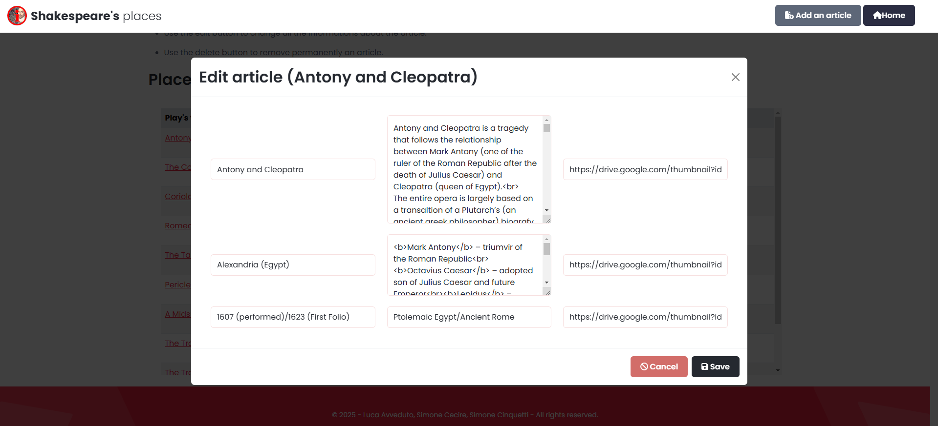
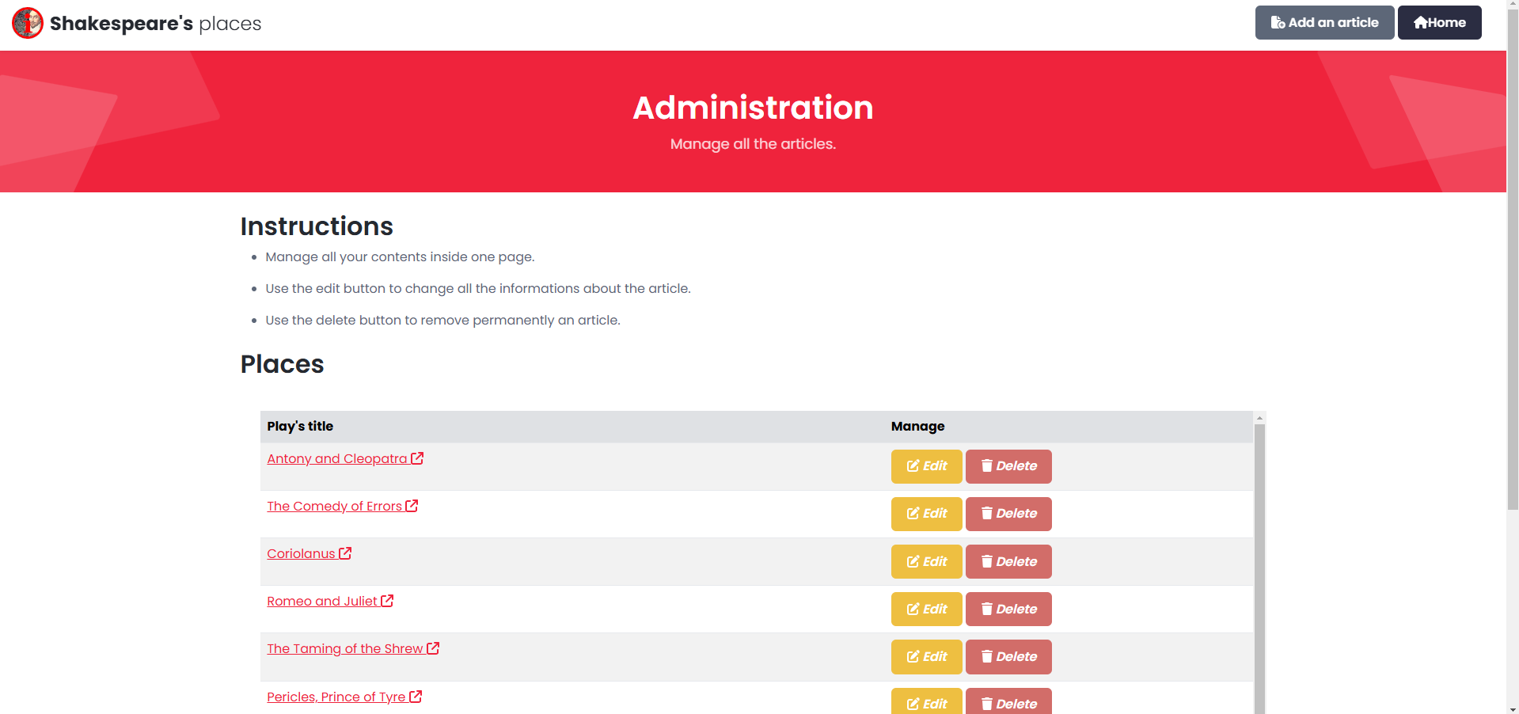
ADD
EDIT

